Slide 1
Lecture 6
Recursion
June 27, 2017
Intuition
Thinking Recursively
Two Views of Recursion

Slide 2
Announcements
Hog is due Friday! Submit by Thursday for 1 EC point
Final strategy autograder now available: see Piazza
Homework 2 due Friday!
Remember that check-offs are happening this week!
Explain one part of a lab or homework that you completed
If you are confused by anything, come to office hours or sign-up for tutoring and mentoring ASAP
Now is the best possible time to learn!
Listen to me blabber about make_adder
Waterproofing construction in Soda is very loud, sorry

Slide 3
Introduction
Functions
Functions
Data
The goals for this week are:
To understand the idea of functional abstraction
To study this idea through:
higher-order functions
recursion (today and tomorrow!)
methods of abstraction
Mutability
Objects
Interpreters
Paradigms
Applications

Slide 4
Review

Slide 5
Describing Functions
Functions take in some input and compute a returned output
Domain is the set of all possible inputs a function may take as arguments
Range is the set of output values a function may possible return
Behavior is the relationship between input and output
def square(x): return x * x
Domain A real number
Range A non-negative real number
Behavior Return the input squared

Slide 6
Functional Abstraction
Python solves problems by evaluating expressions and statements step-by-step
What would Python display? to understand how to evaluate expressions
Environment diagrams to help visualize the interpreter's process
We've been looking at programs step-by-step to learn how Python computes an answer
But, we could view programs as functional abstractions
square(2) always returns 4
square(3) always returns 9
...
Without worrying about how Python evaluates the function

Slide 7
Intuition

Slide 8
Suppose you're waiting in line for a concert.
You can't see the front of the line, but you want to know what your place in line is.
You can't step out of line because you'd lose your spot.
What should you do?

Slide 9
An iterative algorithm might say:
Ask my friend to go to the front of the line.
Count each person in line one-by-one.
Then, tell me the answer.

Slide 10
A recursive algorithm might say:
If you're at the front, you know you're first.
Otherwise, ask the person in front of you, "What number in line are you?"
When the person in front of you figures it out and tells you, add one to that answer.

Slide 11
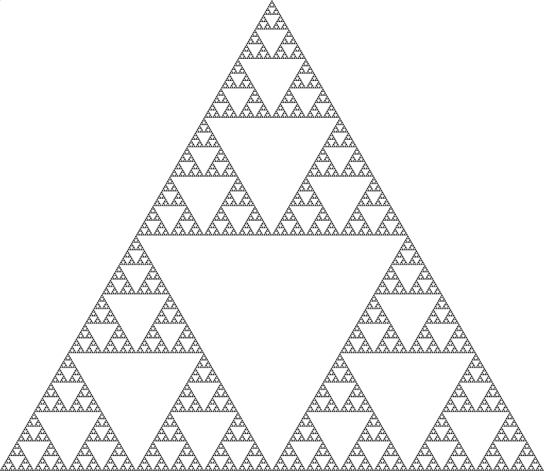
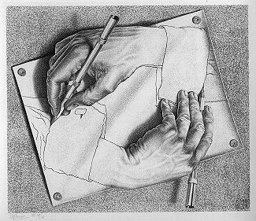
Recursive Functions
A function is called recursive if the body of that function calls itself, either directly or indirectly
This implies that executing the body of a recursive function may require applying that function multiple times
Drawing Hands, by M. C. Escher (lithograph, 1948)

Slide 12
Structure of a Recursive Function
One or more base cases, usually the smallest input.
"If you're at the front, you know you're first."
One or more ways of reducing the problem, and then solving the smaller problem using recursion.
"Ask the person in front, 'What number in line are you?'"
One or more ways of using the solution to each smaller problem to solve our larger problem.
"When the person in front of you figures it out and tells you, add one to that answer."

Slide 13
Thinking Recursively
Demo

Slide 14
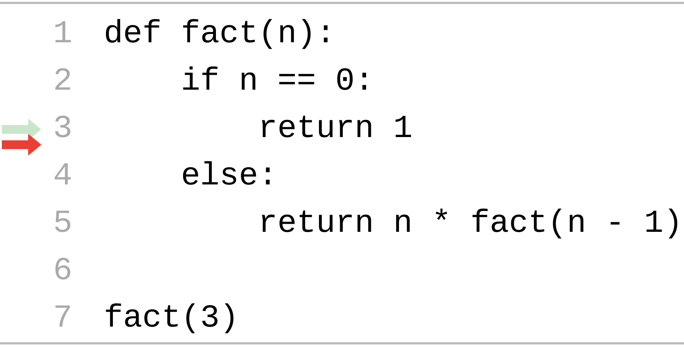
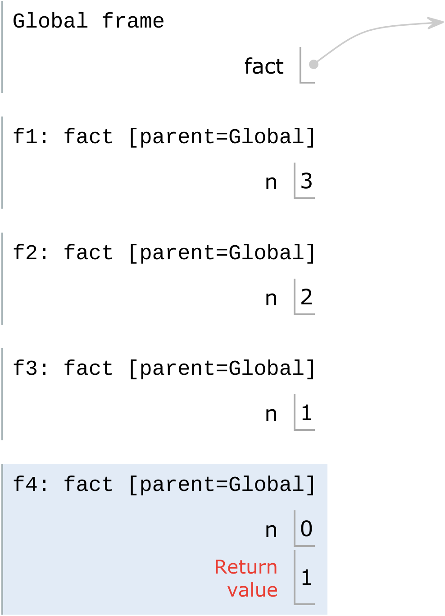
Recursion in Environment Diagrams
What is fact(3)?
What is fact(2)?
The same function fact is called multiple times
Different frames keep track of the different arguments in each call
What n evaluates to depends upon the current environment
Each call to fact solves a simpler problem than the last: smaller n
What is fact(1)?
What is fact(0)?
fact(0) is 1

Slide 15
Two Views of Recursion

Slide 16
Recursive "Leap of Faith"
Is factorial correct?
Verify the base cases.
Are they correct?
Are they exhaustive?
Now, harness the power of functional abstraction!
Assume that factorial(n-1) is correct.
Verify that factorial(n) is correct.
def factorial(n):
if n == 0:
return 1
else:
return n * factorial(n-1)
Functional abstraction: don't worry that factorial is recursive and just assume that factorial gets the right answer!

Slide 17
How to Trust the (Recursive) Process
Look at how we computed factorial(3)
Which required computing factorial(2)
Which required computing factorial(1)
Which required computing factorial(0)
Which we know is 1, thanks to the base case!
Verifying the correctness of recursive functions
Verify that the base cases work as expected
For each larger case, verify that it works by assuming the smaller recursive calls are correct

Slide 18
Recursion by Enumeration
def factorial(n):
if n == 0 or n == 1:
return 1
elif n == 2:
return 2 * 1
elif n == 3:
return 3 * 2 * 1
elif n == 4:
return 4 * 3 * 2 * 1
elif n == 5:
return 5 * 4 * 3 * 2 * 1
elif n == 6:
return 6 * factorial(5)
else:
return n * factorial(n-1)
Is factorial correct?
List out all the cases.
Identify patterns between each case.
Simplify repeated code with recursive calls.
A recursive call is evaluated by Python the same as any other function call.

Slide 19
def count_up(n):
"""Recursively print up to n.
>>> count_up(5)
1
2
3
4
5
"""
"*** YOUR CODE HERE ***"
Demo

Slide 20
def count_up(n): """Recursively print up to n. >>> count_up(5) 1 2 3 4 5 """
if n >= 1:
count_up(n - 1)
print(n)
Implicit base case! if n < 1: do nothing

Slide 21
Solving count_up
Leap of Faith
Base case
Smallest possible input.
if n == 1 or maybe n < 1
Reduce the problem
To print the number before us, try n - 1.
Solve the larger problem
Need to print our own number as well!
print(n)
Enumeration
List the cases
if n == 1: print(1)
if n == 2: print(1) print(2)
Identify the pattern
n == 2 helps n == 3
Simplify with recursion
if n == 3: count_up(2) print(3)

Slide 22
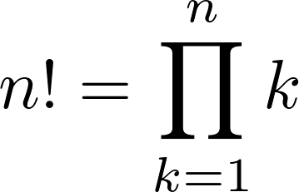
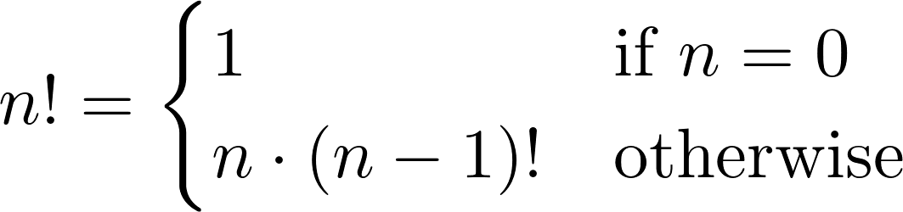
Iteration vs. Recursion
Iteration is a special case of recursion
Converting iteration to recursion is formulaic, but converting recursion to iteration can be more tricky
Iterative
Recursive
def fact_iter(n): total, k = 1, 1 while k <= n: total, k = total*k, k+1 return total
def fact(n): if n == 0: return 1 else: return n * fact(n-1)
Names: n, total, k, fact_iter
Names: n, fact

Slide 23
Summary
Demo
Recursive functions call themselves, either directly or indirectly, in the function body
The motivation for this is to break down the problem into smaller, easier to solve problems
In environment diagrams, each call creates its own frames and keeps track of its own argument values
Recursive functions have base cases, which evaluate without relying on calls to itself, and recursive cases
When writing recursive programs, remember the three parts in the structure of a recursive function
And use both the leap of faith and enumeration

